Slide 1
Data Project Proposal
Presentation
Team 3: Christopher, Malik, Mohammed & Kelly
16th February 2024

Slide 2
Why should we focus on customer retention?
01
Chapter

Slide 3





Customer Retention: Why it matters
In 2022, Lloyds Banking Group lost more customers than it gained in every quarter of the year.
The ratio of customers gained was negative 1.3 in both the third and second quarters of 2022.
1,001
5x more
However, 2023 saw a slight improvement in 2023 for Q1, gaining 1.3 customers for each that left.
Net customer gain in bank account switchers for 2021
Spent on new customer acquisition compared to customer retention
Most research estimates it costs 5 times more to attract new customers than it is to retain them.
Research suggests that for most businesses, around 65% of their business comes from existing customers.
65%
25m
Neobanks present increased challenges, with more people switching and staying.
Research estimate of existing customer contribution to most profits for most businesses.
Average number of LBG customers 2020-2022

Slide 4
The Project Proposal
02
Chapter

Slide 5
Predicting customer churn
Through segmentation analysis and machine learning
Aims:
The questions we seek to answer
Can we successfully predict if a customer is likely to leave?
What factors are most influential to a customer deciding to exit?
Identify and create a machine learning model to best predict potential leavers.
To test this model with a fictional sample dataset.
Identify strengths, limitations and areas of improvements to enhance the model.
Show how we intend to move our plans to Google Cloud Platform Technology

Slide 6
Data Analysis
03
Chapter

Slide 7



Data analysis: key points
Bank Deposits Lost From Leavers
Total Bank Balance Lost
Context
Sample customer churn dataset was obtained from a Public Source.
Good baseline to begin exploring analysis to then move to developing predictive machine modelling
Dataset limited in terms of features, no time series data and limited granular features to explore.
Application with LBG data would be far superior due to the expansive variety and quality of data to tap into.
Complaint Impact
99.5% of exited customers had registered a complaint.
99.5%

Slide 8
Data analysis: key points
Gender
Top Take Aways
50%
Women at least 50% more likely to leave than men across most demographics.
50-59
Age group with the highest rate of leavers
100%
Of customers (61) with 4 products exiting the bank. 100% of them registered a complaint.
£6m
Bank balance lost from these 61 customers alone
Feature Importance excl. complaints
1
Age
2
Number of Products
3
Join Age
8

Slide 9









Recommendations
With LBG’s strategic transformation plan in mind and using LBG data
Accuracy
Precision
Focus
Change
Grow
Focus retention efforts on ages 30 to 60.
Further analysis and data acquisition
Self-Serve analytics tools
Utilise machine learning models to predict leavers
Maximise ROI
Higher Lifetime Value
Stability and Loyalty
Upselling Potential
Current analysis is based on a test sample with limited features.
LBG data would provide more granular detail to help identify more significant factors. E.g. do certain products help with retention.
Provide interactive dashboards focused on key churn features to help colleagues with retention responsibilities identify target customers.
An interactive calculator to predict if a customer is likely leave.
Using identified patterns and correlations we can initiate pre-emptive retention activity.
Adopting cloud technology will enable us to further refine our predictive capabilities.

Slide 10
Machine Learning Exploration
04
Chapter

Slide 11
Machine Learning: Process
Split and Balanced Data
Trained Models
Performance Metrics
Compared Results
Confusion Matrix
Fine Tune Hyperparameters
Selected Best Model
Our Final Recommendation
Evaluated Models
Key Points
Imbalanced dataset needed addressing.
Classification models reviewed: Random Forest, ADA Boost and Decision Tree.
Evaluated models based on:
Accuracy
Precision
Recall
Confusion Matrix
Selected the model that performs best according to the evaluation criteria and that best meets the requirements of the problem and business objectives

Slide 12


Machine Learning: Performance
Accuracy
Precision
Recall
Summary
Random Forest
86%
81%
45%
Random Forest performs the best overall.
AdaBoost has the highest recall for class 1, indicating it misses the smallest volume of positive instances.
We would recommend the Random Forest Model for LBG data as we feel accuracy and precision is most important.
This means we can be more effective in targeting the right customers for retention activity.
1
>
2
ADA Boost
77%
47%
77%
3
Decision Tree
83%
62%
46%

Slide 13
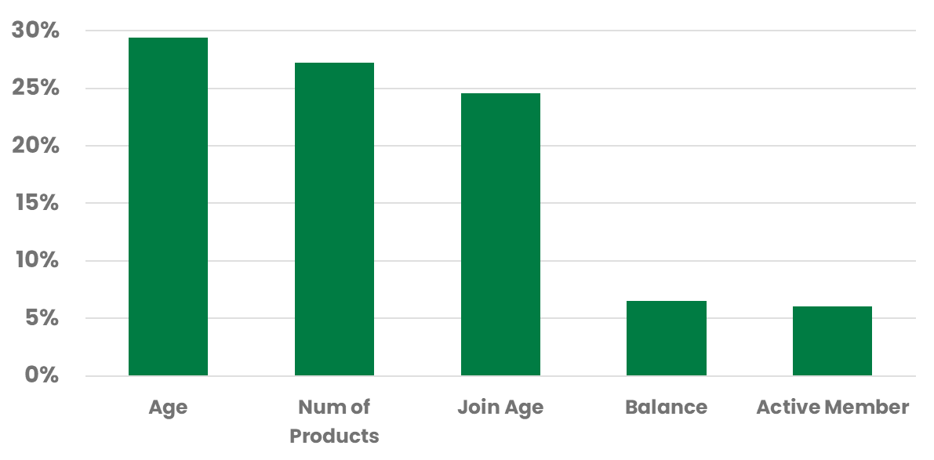
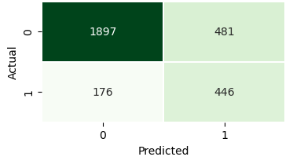
Machine Learning: Best Model
Top 5 Features: Random Forest
Process
Features
Confusion Matrix: Random Forest
Result
Correct Predictions: The model accurately predicts about 82% of the time whether a customer will stay or leave the bank.
Identifying Customers Leaving: It successfully identifies around 65% of the customers who are leaving the bank.

Slide 14
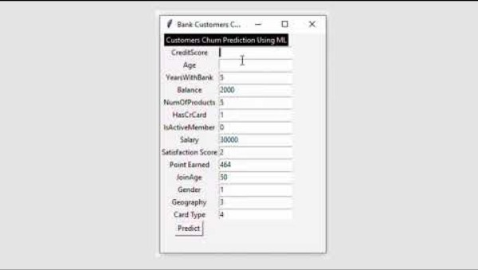
Demonstration: Self-Serve Calculator

Slide 15
Using Google Cloud Technology
05
Chapter

Slide 16

Project benefits from using GCP Technologies
The Next Step
Benefits
…creating higher and more sustainable value
Storage and infrastructure can be scaled up or down to meet demand.
By analysing data in real-time and at scale, LBG can:
GROW profitability,
FOCUS on value-add
activity
CHANGE to optimise
retention capabilities.
To fully realise our data and insight capability, moving this project to Google Cloud Platform will be hugely beneficial.
Scalablity
Removes the need to manage complex infrastructure. Allowing the focus on modelling and testing.
Managed Service
Can seamlessly integrate services in one place for an optimised end-to-end solution.
Integration

Slide 17

Architecture, Infrastructure & Skills
Skills
Data Storage
Model Training
Model Evaluation
Essential skills: basic data and programming skills.
Desired skills SQL proficiency, machine learning concepts, Python programming, statistics, data visualization, and cloud platform experience.
Big Query
Vertex AI
Big Query & Vertex AI
1
Performance
LBG can run larger queries and get better modelling results by using a tool that can handle huge data sets in one location.
1
Good for different technical abilities
With lots of automated tools and a no-code environment modelling isn’t just reserved for data scientists.
1
Visuals & Alerts
Automated visuals and dashboards means we can quickly assess how the model is performing.
Automatic alerts helps us identify problems with the model faster and deploy fixes.
Deployment
Vertex AI
1
Integration: AI Platform Prediction
Data colleagues don’t need to worry about managing the model’s availability or other technical aspects – GCP does it all!
Focus
Change
Grow

Slide 18

Acquiring new customers is important, but retaining them accelerates profitability.

Slide 19
Thank You

